Slide 1
Software QA and Testing with Automation using Selenium IDE Course 1, Class 2 Deck 2
Instructor
David F Wagoner
PMP, CSQE, CMQ/OE

Slide 2
Goal of Automating
To economize the testing effort and increase testing coverage and efficiency and effectiveness
When repetitive tests and system functions can be automated the elements that don’t frequently change (e.g., logins, site info, copyright notices…etc.) can be automated and run at a lower cost in ensuing releases
Automation increases efficiency by using one human resource to execute many tests at a higher ratio than manual execution provides
Automation allows a test team to focus their efforts on the areas that do frequently change and new system functions while performing regression tests using software

Slide 3
Automation Cost/Benefit
Costs
Costly
Often requires more, specialized resources
Difficult to maintain
Benefits
Speed of Test Execution
Efficiency
Accuracy and Precision
Resource Reduction/Re-Tasking

Slide 4
No Silver Bullet
When managers and executive see a situation where fewer resources can accomplish more, they begin to see it as a panacea to all their ills and want to push forward.
While tempting to support this because of better funding and acceptance, don’t. It’s not a panacea and will cost you dearly later. Keep the goals realistic
The road to automation is long and requires discipline

Slide 5
Automation Fundamentals
Prerequisites
Repeated releases
Some web sites do perform successive releases over a period of months or years
Many web sites are one-off shops and cannot benefit from automation unless there’s a common architecture among product lines
Process Stability and repeatability
Using a defined SDLC that is used repeatedly across projects or product teams

Slide 6
Automation Fundamentals
Prerequisites (cont.)
Repeated successful test projects
This is an industry best practice. Walk first then run
The process can’t be automated unless the process has been worked out and with demonstrated benefits
Stable Product Design
If a design or the objects or architecture of the web site changes radically from release to release, it is not worth automating because scripts will require radical changes each time.

Slide 7
Type of Test Automation
Functional
Testing interfaces and system functions of a web site (or software) to identify defects
This is the focus of this course
Others – not covered by this course
Hardware automation and Network Monitoring
Server performance
White-box integration testing
Build and configuration testing
Unit, Stub/Driver testing

Slide 8
Type of Automation Tools
There are two types of tools
Macro Level Recording and Playback
Record and Catalog Test scripts
Simplest approach but lacks vigor and usually requires just as much effort and manual testing
Testing Suites
These have more rigorous capabilities to:
Record, catalog and queue sets of test scripts
Programming interfaces to enable finer levels of control and use of predefined test data
Also have capabilities to test on many servers concurrently
Ability to capture and recover from errors detected

Slide 9
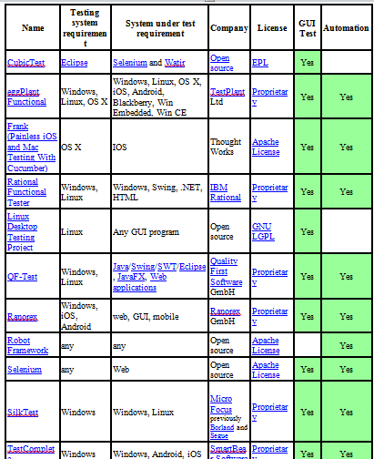
Testing Tools

Slide 10
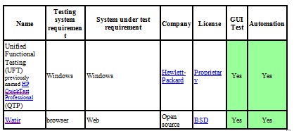
Testing Tools (Cont.)

Slide 11
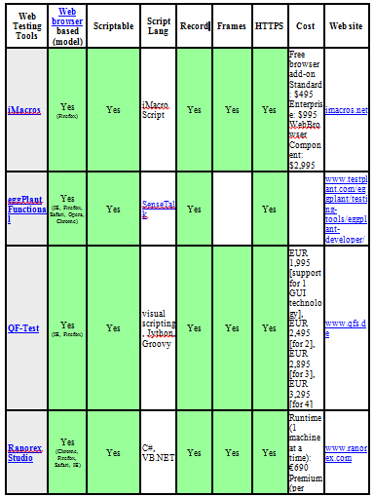
Web Testing Tools

Slide 12
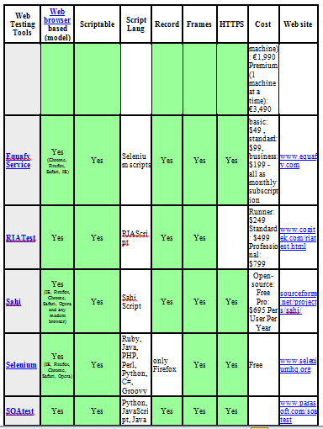
Web Testing Tools

Slide 13
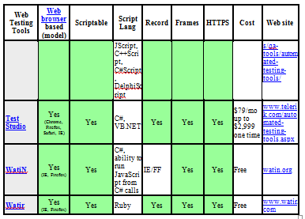
Web Testing Tools

Slide 14
Test Documentation
IEEE – The Institute for Electrical and Electronic Engineering
IEEE Standard 829 defines the scope and content of test documentation

Slide 15
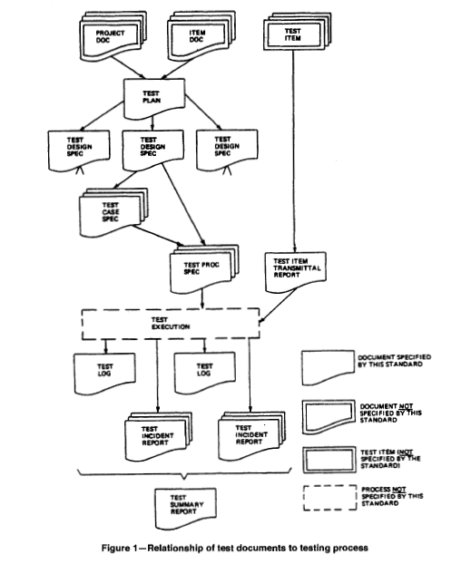
Test Documentation

Slide 16
The Test Plan
Test Plan Id
Introduction
Scope
Relationship to other Plans
Test Items
Features to be tested
Features not to be Tested
Approach
Pass/Fail Criteria
Suspension/Resumption Criteria
Test Deliverables
Test Tasks
Test Environment
Responsibilities
Staff/Training Needs
Schedule
Risk Management
Approvals

Slide 17
Lab
Planning a Testing Project
Define the site we are building
Look at the information that comprises test planning documents
Develop a test plan for our registration web site
Develop the Requirements for this web site
Requirements statements
RTM

Slide 18
Selenium
Selenium is a state-of-the-practice test automation tool used by many web development companies
Includes a macro recorder and very basic library function. This will be used in the section of the course (Part I)
The Selenium Web Driver is the more rigorous automated suite with several programming interfaces (perl, python…etc.). This will be used in Part II of this course. We’ll be using Python.

Slide 19
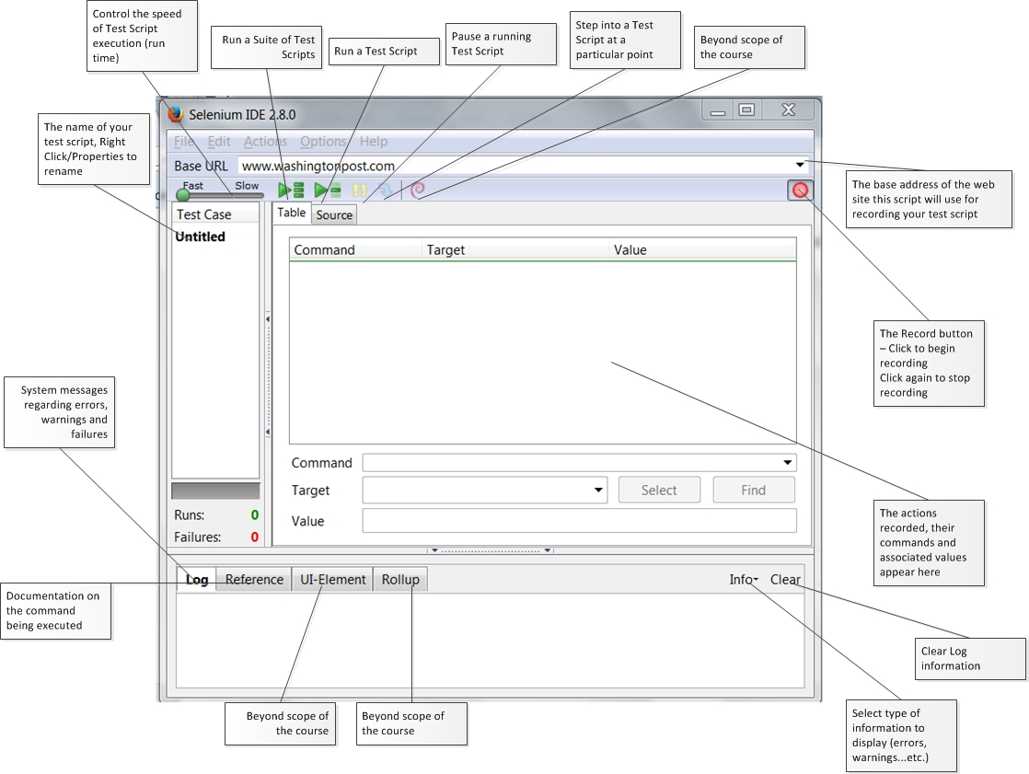

Slide 20
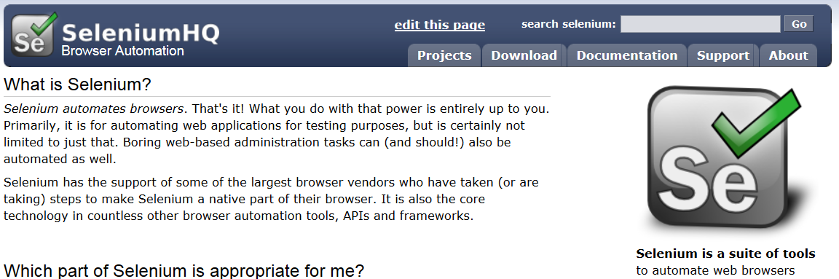
Downloading Plugin
This will need to be done again at the beginning of each class
www.seleniumhq.org – click on Download

Slide 21
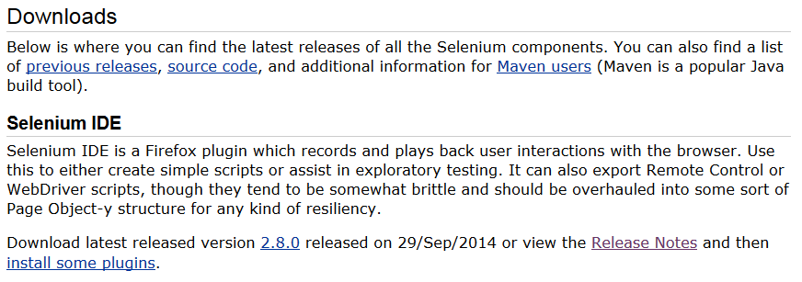
Downloading Plugin
Download the latest release, per bottom line below, click install in the Firefox window, Then restart the browser

Slide 22
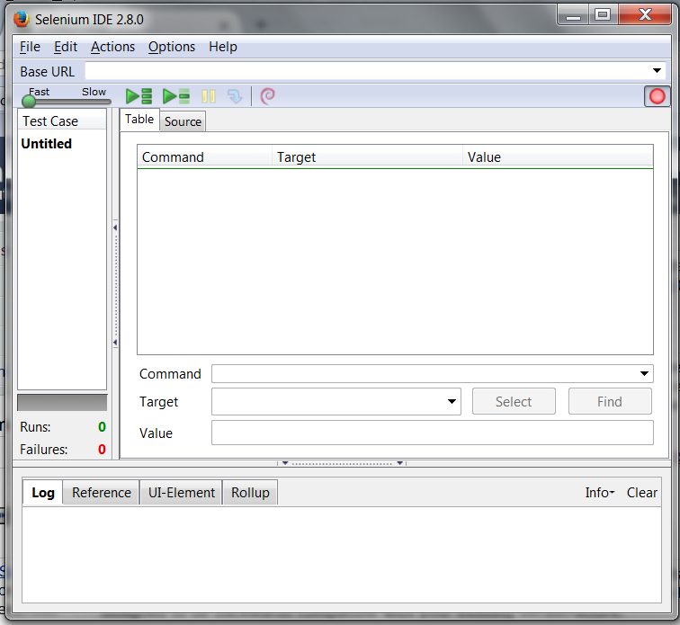
Opening the IDE
When Firefox restarts, click on Tools, Selenium IDE

Slide 23

Script Recording
Open up the web site to be tested
Click on the Record button
Begin browsing to build your test case
After exploring one page, store the test case using a meaningful name (e.g., ‘Main’ for main page of a site, ‘Login’ for the login page…etc.
Then proceed to the next page on the site to be tested and record another script

Slide 24
Running Scripts
Select a test script
Press Run
Next, Run the same script and move the speed control

Slide 25
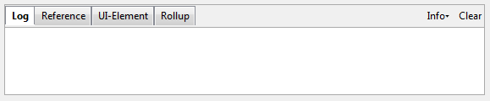
The Log
The bottom of the IDE contains a tabbed window
The log tab is used to log execution messages so you can see when a test succeeds or fails
This information is valuable for determining the cause of problems with your script
Press the Clear button to clear out old, irrelevant messages

